Slide 1
Creating Functions

Slide 2
Objectives
After completing this lesson, you should be able to do the following:
  Differentiate between a procedure and a function
  Describe the uses of functions
  Create stored functions
  Invoke a function
  Remove a function
Notes:
Oracle Database 11g: Develop PL/SQL Program Units 3 - <number>
Lesson Aim
In this lesson, you learn how to create, invoke, and maintain functions.

Slide 3
Overview of Stored Functions
A function:
  Is a named PL/SQL block that returns a value
  Can be stored in the database as a schema object for repeated execution
  Is called as part of an expression or is used to provide a parameter value
Notes:
Oracle Database 11g: Develop PL/SQL Program Units 3 - <number>
Overview of Stored Functions
A function is a named PL/SQL block that can accept parameters, be invoked, and return a value. In general, you use a function to compute a value. Functions and procedures are structured alike. A function must return a value to the calling environment, whereas a procedure returns zero or more values to its calling environment. Like a procedure, a function has a header, a declarative section, an executable section, and an optional exception-handling section. A function must have a RETURN clause in the header and at least one RETURN statement in the executable section.
Functions can be stored in the database as schema objects for repeated execution. A function that is stored in the database is referred to as a stored function. Functions can also be created on client-side applications.
Functions promote reusability and maintainability. When validated, they can be used in any number of applications. If the processing requirements change, only the function needs to be updated.
A function may also be called as part of a SQL expression or as part of a PL/SQL expression. In the context of a SQL expression, a function must obey specific rules to control side effects. In a PL/SQL expression, the function identifier acts like a variable whose value depends on the parameters passed to it.

Slide 4
Creating Functions
The PL/SQL block must have at least one RETURN statement.
CREATE [OR REPLACE] FUNCTION function_name
[(parameter1 [mode1] datatype1, . . .)]
RETURN datatype IS|AS
[local_variable_declarations;
. . .]
BEGIN
-- actions;
RETURN expression;
END [function_name];
PL/SQL Block
Notes:
Oracle Database 11g: Develop PL/SQL Program Units 3 - <number>
Syntax for Creating Functions
A function is a PL/SQL block that returns a value. A RETURN statement must be provided to return a value with a data type that is consistent with the function declaration.
You create new functions with the CREATE FUNCTION statement, which may declare a list of parameters, must return one value, and must define the actions to be performed by the standard PL/SQL block.
You should consider the following points about the CREATE FUNCTION statement:
The REPLACE option indicates that if the function exists, it is dropped and replaced with the new version that is created by the statement.
The RETURN data type must not include a size specification.
The PL/SQL block starts with a BEGIN after the declaration of any local variables and ends with an END, optionally followed by the function_name.
There must be at least one RETURN expression statement.
You cannot reference host or bind variables in the PL/SQL block of a stored function.
Note: Although the OUT and IN OUT parameter modes can be used with functions, it is not good programming practice to use them with functions. However, if you need to return more than one value from a function, consider returning the values in a composite data structure such as a PL/SQL record or a PL/SQL table.

Slide 5
The Difference Between
Procedures and Functions
Procedures | Functions
Execute as a PL/SQL statement | Invoke as part of an expression
Do not contain RETURN clause in the header | Must contain a RETURN clause in the header
Can pass values (if any) using output parameters | Must return a single value
Can contain a RETURN statement without a value | Must contain at least one RETURN statement
Notes:
The Difference Between Procedures and Functions
You create a procedure to store a series of actions for later execution. A procedure can contain zero or more parameters that can be transferred to and from the calling environment, but a procedure does not have to return a value. A procedure can call a function to assist with its actions.
Note: A procedure containing a single OUT parameter would be better rewritten as a function returning the value.
You create a function when you want to compute a value that must be returned to the calling environment. A function can contain zero or more parameters that are transferred from the calling environment. Functions typically return only a single value, and the value is returned through a RETURN statement. The functions used in SQL statements should not use OUT or IN OUT mode parameters. Although a function using output parameters can be used in a PL/SQL procedure or block, it cannot be used in SQL statements.

Slide 6

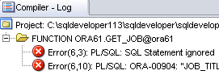










Creating and Running Functions: Overview
View errors/warnings
in SQL Developer
YES
Use SHOW ERRORS
command in SQL*Plus
Create/edit function
Compiler
warnings/errors?
View compiler
warnings/errors
NO
Use USER/ALL/DBA_
ERRORS views
Invoke function
Notes:
Creating and Running Functions: Overview
The diagram in the slide illustrates the basic steps involved in creating and running a function:
1. Create the function using SQL Developer’s Object Navigator tree or the SQL Worksheet area.
2. Compile the function. The function is created in the database. The CREATE FUNCTION statement creates and stores source code and the compiled m-code in the database. To compile the function, right-click the function’s name in the Object Navigator tree, and then click Compile.
3. If there are compilation warning or errors, you can view (and then correct) the warnings or errors using one of the following methods:
Using the SQL Developer interface (the Compiler – Log tab)
Using the SHOW ERRORS SQL*Plus command
Using the USER/ALL/DBA_ERRORS views
4. After successful compilation, invoke the function to return the desired value.

Slide 7
Creating and Invoking a Stored Function Using the CREATE FUNCTION Statement: Example
CREATE OR REPLACE FUNCTION get_sal
(p_id employees.employee_id%TYPE) RETURN NUMBER IS
v_sal employees.salary%TYPE := 0;
BEGIN
SELECT salary
INTO v_sal
FROM employees
WHERE employee_id = p_id;
RETURN v_sal;
END get_sal; /
-- Invoke the function as an expression or as
-- a parameter value.
EXECUTE dbms_output.put_line(get_sal(100))
Notes:
Oracle Database 11g: Develop PL/SQL Program Units 3 - <number>
Stored Function: Example
The get_sal function is created with a single input parameter and returns the salary as a number. Execute the command as shown, or save it in a script file and run the script to create the get_sal function.
The get_sal function follows a common programming practice of using a single RETURN statement that returns a value assigned to a local variable. If your function has an exception section, then it may also contain a RETURN statement.
Invoke a function as part of a PL/SQL expression because the function will return a value to the calling environment. The second code box uses the SQL*Plus EXECUTE command to call the DBMS_OUTPUT.PUT_LINE procedure whose argument is the return value from the function get_sal. In this case, get_sal is invoked first to calculate the salary of the employee with ID 100. The salary value returned is supplied as the value of the DBMS_OUTPUT.PUT_LINE parameter, which displays the result (if you have executed a SET SERVEROUTPUT ON).
Note: A function must always return a value. The example does not return a value if a row is not found for a given id. Ideally, create an exception handler to return a value as well.

Slide 8

Using Different Methods for Executing Functions
-- As a PL/SQL expression, get the results using host variables
VARIABLE b_salary NUMBER
EXECUTE :b_salary := get_sal(100)
-- As a PL/SQL expression, get the results using a local
-- variable
DECLARE
sal employees.salary%type;
BEGIN
sal := get_sal(100);
DBMS_OUTPUT.PUT_LINE('The salary is: '|| sal);
END;/
Notes:
Oracle Database 11g: Develop PL/SQL Program Units 3 - <number>
Using Different Methods for Executing Functions
If functions are well designed, they can be powerful constructs. Functions can be invoked in the following ways:
As part of PL/SQL expressions: You can use host or local variables to hold the returned value from a function. The first example in the slide uses a host variable and the second example uses a local variable in an anonymous block.
Note: The benefits and restrictions that apply to functions when used in a SQL statement are discussed on the next few pages.

Slide 9
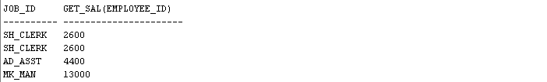

Using Different Methods for Executing Functions
-- Use as a parameter to another subprogram
EXECUTE dbms_output.put_line(get_sal(100))
-- Use in a SQL statement (subject to restrictions)
SELECT job_id, get_sal(employee_id) FROM employees;
. . .
Notes:
Oracle Database 11g: Develop PL/SQL Program Units 3 - <number>
Using Different Methods for Executing Functions (continued)
As a parameter to another subprogram: The third example in the slide demonstrates this usage. The get_sal function with all its arguments is nested in the parameter required by the DBMS_OUTPUT.PUT_LINE procedure. This comes from the concept of nesting functions as discussed in the course titled Oracle Database 11g: SQL Fundamentals I.
As an expression in a SQL statement: The last example shows how a function can be used as a single-row function in a SQL statement.

Slide 10
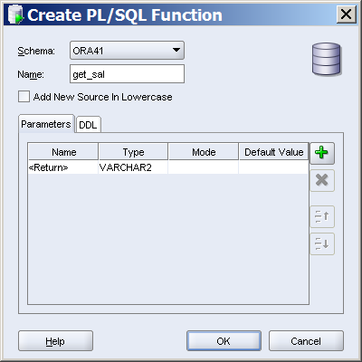
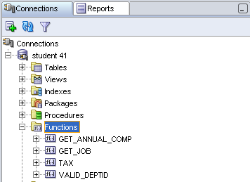
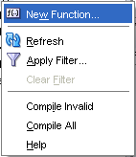
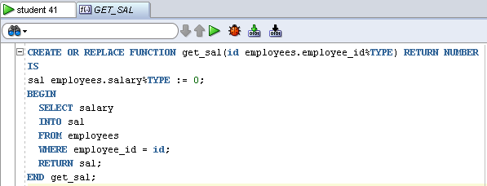
Creating and Compiling
Functions Using SQL Developer
1
2
3
4
Notes:
Creating and Compiling Functions Using SQL Developer
You can create a new function in SQL Developer using the following steps:
Right-click the Functions node, and then select New Function. The Create PL/SQL Function dialog box is displayed.
Select the schema, function name, and the parameters list (using the + icon), and then click OK. The code editor for the function is displayed.
Enter the function’s code.
To compile the function, click the Compile icon.
Note
To create a new function in SQL Developer, you can also enter the code in the SQL Worksheet, and then click the Run Script icon.
For additional information about creating functions in SQL Developer, access the appropriate online help topic titled “Create PL/SQL Subprogram Function or Procedure.”

Slide 11
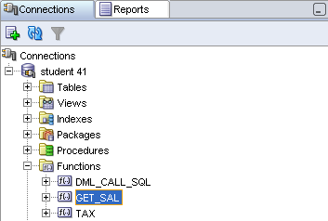
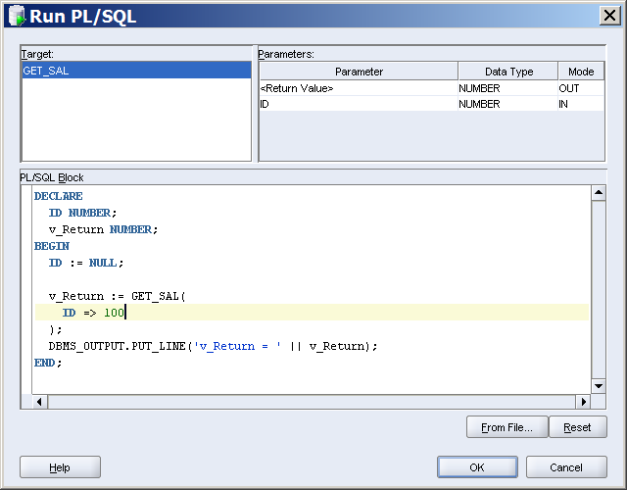
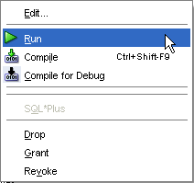
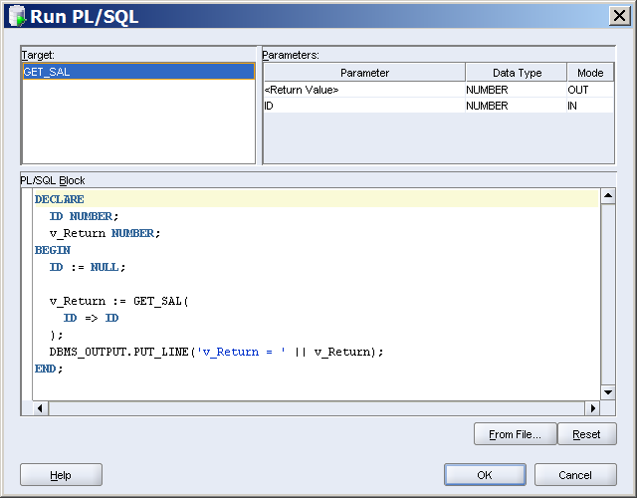
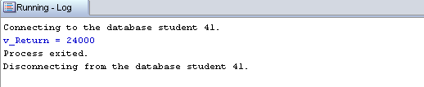
Executing Functions Using SQL Developer
2
1
3
`
Replace ID with
the actual value
`
Notes:
Executing Functions Using SQL Developer
You can execute a function in SQL Developer using the following steps:
1. Right-click the Functions node.
2. Right-click the function’s name, and then select Run. The Run PL/SQL dialog box is displayed.
3. Replace the second parameter name with the actual parameter value as shown in the slide example, and then click OK.
Note: For additional information about running functions in SQL Developer, access the online help topic titled “Running and Debugging Functions and Procedures.”

Slide 12
Advantages of User-Defined
Functions in SQL Statements
  Can extend SQL where activities are too complex, too awkward, or unavailable with SQL
  Can increase efficiency when used in the WHERE clause to filter data, as opposed to filtering the data in the application
  Can manipulate data values
Notes:
Oracle Database 11g: Develop PL/SQL Program Units 3 - <number>
Advantages of User-Defined Functions in SQL Statements
SQL statements can reference PL/SQL user-defined functions anywhere a SQL expression is allowed. For example, a user-defined function can be used anywhere that a built-in SQL function, such as UPPER(), can be placed.
Advantages
Permits calculations that are too complex, awkward, or unavailable with SQL
Increases data independence by processing complex data analysis within the Oracle server, rather than by retrieving the data into an application
Increases efficiency of queries by performing functions in the query rather than in the application
Manipulates new types of data (for example, latitude and longitude) by encoding character strings and using functions to operate on the strings

Slide 13
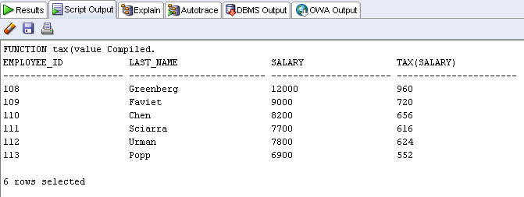
Using a Function in a SQL Expression: Example
CREATE OR REPLACE FUNCTION tax(p_value IN NUMBER)
RETURN NUMBER IS
BEGIN
RETURN (p_value * 0.08);
END tax;
/
SELECT employee_id, last_name, salary, tax(salary)
FROM employees
WHERE department_id = 100;
Notes:
Oracle Database 11g: Develop PL/SQL Program Units 3 - <number>
Function in SQL Expressions: Example
The example in the slide shows how to create a tax function to calculate income tax. The function accepts a NUMBER parameter and returns the calculated income tax based on a simple flat tax rate of 8%.
To execute the code shown in the slide example in SQL Developer, enter the code in the SQL Worksheet, and then click the Run Script icon. The tax function is invoked as an expression in the SELECT clause along with the employee ID, last name, and salary for employees in a department with ID 100. The return result from the tax function is displayed with the regular output from the query.

Slide 14
Calling User-Defined Functions in SQL Statements
User-defined functions act like built-in single-row functions and can be used in:
  The SELECT list or clause of a query
  Conditional expressions of the WHERE and HAVING clauses
  The CONNECT BY, START WITH, ORDER BY, and GROUP BY clauses of a query
  The VALUES clause of the INSERT statement
  The SET clause of the UPDATE statement
Notes:
Oracle Database 11g: Develop PL/SQL Program Units 3 - <number>
Calling User-Defined Functions in SQL Statements
A PL/SQL user-defined function can be called from any SQL expression where a built-in single-row function can be called as shown in the following example:
SELECT employee_id, tax(salary)
FROM employees
WHERE tax(salary) > (SELECT MAX(tax(salary))
FROM employees
WHERE department_id = 30)
ORDER BY tax(salary) DESC;

Slide 15
Restrictions When Calling Functions from SQL Expressions
  User-defined functions that are callable from SQL expressions must:
    Be stored in the database
    Accept only IN parameters with valid SQL data types, not PL/SQL-specific types
    Return valid SQL data types, not PL/SQL-specific types
  When calling functions in SQL statements:
    You must own the function or have the EXECUTE privilege
Notes:
Oracle Database 11g: Develop PL/SQL Program Units 3 - <number>
Restrictions When Calling Functions from SQL Expressions
The user-defined PL/SQL functions that are callable from SQL expressions must meet the following requirements:
The function must be stored in the database.
The function parameters must be IN and of valid SQL data types.
The functions must return data types that are valid SQL data types. They cannot be PL/SQL-specific data types such as BOOLEAN, RECORD, or TABLE. The same restriction applies to the parameters of the function.
The following restrictions apply when calling a function in a SQL statement:
Parameters must use positional notation. Named notation is not supported.
You must own or have the EXECUTE privilege on the function.
Other restrictions on a user-defined function include the following:
It cannot be called from the CHECK constraint clause of a CREATE TABLE or ALTER TABLE statement.
It cannot be used to specify a default value for a column.
Note: Only stored functions are callable from SQL statements. Stored procedures cannot be called unless invoked from a function that meets the preceding requirements.

Slide 16
Controlling Side Effects When
Calling Functions from SQL Expressions
Functions called from:
  A SELECT statement cannot contain DML statements
  An UPDATE or DELETE statement on a table T cannot query or contain DML on the same table T
  SQL statements cannot end transactions (that is, cannot execute COMMIT or ROLLBACK operations)
Note: Calls to subprograms that break these restrictions are also not allowed in the function.
Notes:
Oracle Database 11g: Develop PL/SQL Program Units 3 - <number>
Controlling Side Effects When Calling Functions from SQL Expressions
To execute a SQL statement that calls a stored function, the Oracle server must know whether the function is free of specific side effects. The side effects are unacceptable changes to database tables.
Additional restrictions apply when a function is called in expressions of SQL statements:
When a function is called from a SELECT statement or a parallel UPDATE or DELETE statement, the function cannot modify database tables.
When a function is called from an UPDATE or DELETE statement, the function cannot query or modify database tables modified by that statement.
When a function is called from a SELECT, INSERT, UPDATE, or DELETE statement, the function cannot execute directly or indirectly through another subprogram or SQL transaction control statements such as:
A COMMIT or ROLLBACK statement
A session control statement (such as SET ROLE)
A system control statement (such as ALTER SYSTEM)
Any DDL statements (such as CREATE) because they are followed by an automatic commit

Slide 17
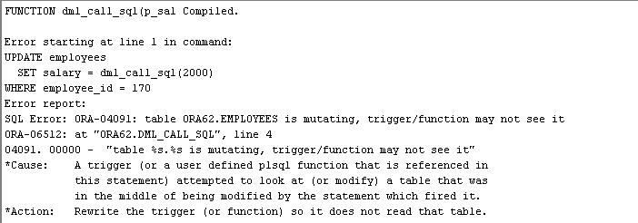
Restrictions on Calling Functions from SQL: Example
CREATE OR REPLACE FUNCTION dml_call_sql(p_sal NUMBER)
RETURN NUMBER IS
BEGIN
INSERT INTO employees(employee_id, last_name,
email, hire_date, job_id, salary)
VALUES(1, 'Frost', 'jfrost@company.com',
SYSDATE, 'SA_MAN', p_sal);
RETURN (p_sal + 100);
END;
UPDATE employees
SET salary = dml_call_sql(2000)
WHERE employee_id = 170;
Notes:
Oracle Database 11g: Develop PL/SQL Program Units 3 - <number>
Restrictions on Calling Functions from SQL: Example
The dml_call_sql function in the slide contains an INSERT statement that inserts a new record into the EMPLOYEES table and returns the input salary value incremented by 100. This function is invoked in the UPDATE statement that modifies the salary of employee 170 to the amount returned from the function. The UPDATE statement fails with an error indicating that the table is mutating (that is, changes are already in progress in the same table). In the following example, the query_call_sql function queries the SALARY column of the EMPLOYEES table:
CREATE OR REPLACE FUNCTION query_call_sql(p_a NUMBER)
RETURN NUMBER IS
v_s NUMBER;
BEGIN
SELECT salary INTO v_s FROM employees
WHERE employee_id = 170;
RETURN (v_s + p_a);
END;
When invoked from the following UPDATE statement, it returns the error message similar to the error message shown in the slide:
UPDATE employees SET salary = query_call_sql(100)
WHERE employee_id = 170;

Slide 18
Named and Mixed Notation from SQL
  PL/SQL allows arguments in a subroutine call to be specified using positional, named, or mixed notation
  Prior to Oracle Database 11g, only the positional notation is supported in calls from SQL
  Starting in Oracle Database 11g, named and mixed notation can be used for specifying arguments in calls to PL/SQL subroutines from SQL statements
  For long parameter lists, with most having default values, you can omit values from the optional parameters
  You can avoid duplicating the default value of the optional parameter at each call site

Slide 19

Named and Mixed Notation from SQL: Example
CREATE OR REPLACE FUNCTION f(
p_parameter_1 IN NUMBER DEFAULT 1,
p_parameter_5 IN NUMBER DEFAULT 5)
RETURN NUMBER
IS
v_var number;
BEGIN
v_var := p_parameter_1 + (p_parameter_5 * 2);
RETURN v_var;
END f;
/
SELECT f(p_parameter_5 => 10) FROM DUAL;
Notes:
Example of Using Named and Mixed Notation from a SQL Statement
In the slide example, the call to the function f within the SQL SELECT statement uses the named notation. Before Oracle Database 11g, you could not use the named or mixed notation when passing parameters to a function from within a SQL statement. Before Oracle Database 11g, you received the following error:
SELECT f(p_parameter_5 => 10) FROM DUAL;
ORA-00907: missing right parenthesis

Slide 20
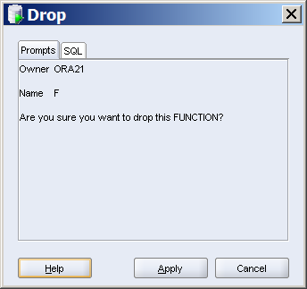
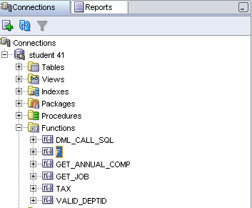
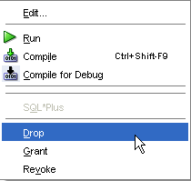
Removing Functions: Using the DROP
SQL Statement or SQL Developer
  Using the DROP statement:
  Using SQL Developer:
DROP FUNCTION f;
2
1
3
Notes:
Removing Functions
Using the DROP statement
When a stored function is no longer required, you can use a SQL statement in SQL*Plus to drop it. To remove a stored function by using SQL*Plus, execute the DROP FUNCTION SQL command.
Using CREATE OR REPLACE Versus DROP and CREATE
The REPLACE clause in the CREATE OR REPLACE syntax is equivalent to dropping a function and re-creating it. When you use the CREATE OR REPLACE syntax, the privileges granted on this object to other users remain the same. When you DROP a function and then re-create it, all the privileges granted on this function are automatically revoked.
Using SQL Developer
To drop a function in SQL Developer, right-click the function name in the Functions node, and then select Drop. The Drop dialog box is displayed. To drop the function, click Apply.

Slide 21
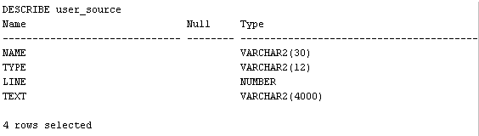
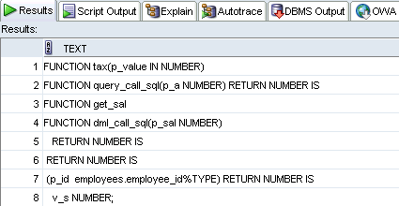
Viewing Functions
Using Data Dictionary Views
DESCRIBE USER_SOURCE
SELECT text
FROM user_source
WHERE type = 'FUNCTION'
ORDER BY line;
. . .
Notes:
Viewing Functions Using Data Dictionary Views
The source code for PL/SQL functions is stored in the data dictionary tables. The source code is accessible for PL/SQL functions that are successfully or unsuccessfully compiled. To view the PL/SQL function code stored in the data dictionary, execute a SELECT statement on the following tables where the TYPE column value is FUNCTION:
The USER_SOURCE table to display the PL/SQL code that you own
The ALL_SOURCE table to display the PL/SQL code to which you have been granted the EXECUTE right by the owner of that subprogram code
The second slide example uses the USER_SOURCE table to display the source code for all the functions in your schema.
You can also use the USER_OBJECTS data dictionary view to display a list of your function names.

Slide 22
Quiz
A PL/SQL function:
  Can be invoked as part of an expression
  Must contain a RETURN clause in the header
  Must return a single value
  Must contain at least one RETURN statement
  Does not contain a RETURN clause in the header
Notes:
Answers: 1, 2, 3, 4

Slide 23
Summary
In this lesson, you should have learned how to:
  Differentiate between a procedure and a function
  Describe the uses of functions
  Create stored functions
  Invoke a function
  Remove a function
Notes:
Oracle Database 11g: Develop PL/SQL Program Units 3 - <number>
Summary
A function is a named PL/SQL block that must return a value. Generally, you create a function to compute and return a value, and you create a procedure to perform an action.
A function can be created or dropped.
A function is invoked as a part of an expression.

Slide 24
Practice 3: Overview
This practice covers the following topics:
  Creating stored functions:
    To query a database table and return specific values
    To be used in a SQL statement
    To insert a new row, with specified parameter values, into a database table
    Using default parameter values
  Invoking a stored function from a SQL statement
  Invoking a stored function from a stored procedure
Notes:
Oracle Database 11g: Develop PL/SQL Program Units 3 - <number>
Practice 3: Overview
It is recommended to use SQL Developer for this practice.

Slide 25
Notes:
Oracle Database 11g: Develop PL/SQL Program Units 3 - <number>
Practice 3
1. Create and invoke the GET_JOB function to return a job title.
Create and compile a function called GET_JOB to return a job title.
Create a VARCHAR2 host variable called b_title, allowing a length of 35 characters. Invoke the function with the SA_REP job ID to return the value in the host variable, and then print the host variable to view the result.
2. Create a function called GET_ANNUAL_COMP to return the annual salary computed from an employee’s monthly salary and commission passed as parameters.
a. Create the GET_ANNUAL_COMP function, which accepts parameter values for the monthly salary and commission. Either or both values passed can be NULL, but the function should still return a non-NULL annual salary. Use the following basic formula to calculate the annual salary:
(salary*12) + (commission_pct*salary*12)
b. Use the function in a SELECT statement against the EMPLOYEES table for employees in department 30.
3. Create a procedure, ADD_EMPLOYEE, to insert a new employee into the EMPLOYEES table. The procedure should call a VALID_DEPTID function to check whether the department ID specified for the new employee exists in the DEPARTMENTS table.
a. Create a function called VALID_DEPTID to validate a specified department ID and return a BOOLEAN value of TRUE if the department exists.

Slide 26
Notes:
Oracle Database 11g: Develop PL/SQL Program Units 3 - <number>
Practice 3 (continued)
Create the ADD_EMPLOYEE procedure to add an employee to the EMPLOYEES table. The row should be added to the EMPLOYEES table if the VALID_DEPTID function returns TRUE; otherwise, alert the user with an appropriate message. Provide the following parameters:
first_name
last_name
email
job: Use ‘SA_REP’ as the default
mgr: Use 145 as the default
sal: Use 1000 as the default
comm: Use 0 as the default
deptid: Use 30 as the default
Use the EMPLOYEES_SEQ sequence to set the employee_id column
Set the hire_date column to TRUNC(SYSDATE)
Call ADD_EMPLOYEE for the name Jane Harris in department 15, leaving other parameters with their default values. What is the result?
Add another employee named Joe Harris in department 80, leaving remaining parameters with their default values. What is the result?

